Slide 1
Log In / Sign Up
Company Name
Quality healthcare anytime, anywhere
Specialty Community (optional) Availability Date Other Filters
Search
Top Rated Doctors
Doctors with a 5 star rating for over 90% of patients
Dr. Sehej Johal
Radiologist
4.8 Star Rating
“Dr. Johal is an awesome
Doctor and really knew his stuff”
Dr. Sehej Johal
Radiologist
4.8 Star Rating
“Dr. Johal is an awesome
Doctor and really knew his stuff”
Dr. Sehej Johal
Radiologist
4.8 Star Rating
“Dr. Johal is an awesome
Doctor and really knew his stuff”
Book Appointment
Book Appointment
Book Appointment
Notes:
Home Page

Slide 2
Company Name
Quality healthcare anytime, anywhere
Specialty Community (optional) Availability Date Other Filters
Search
Top Rated Doctors
Doctors with a 5 star rating for over 90% of patients
Dr. Sehej Johal
Radiologist
4.8 Star Rating
“Dr. Johal is an awesome
Doctor and really knew his stuff”
Dr. Sehej Johal
Radiologist
4.8 Star Rating
“Dr. Johal is an awesome
Doctor and really knew his stuff”
Dr. Sehej Johal
Radiologist
4.8 Star Rating
“Dr. Johal is an awesome
Doctor and really knew his stuff”
Book Appointment
Book Appointment
Book Appointment
Notes:
Home Page (Signed In)

Slide 3

Company Name
Quality healthcare anytime, anywhere
Log In / Sign Up
Radiologist Bay Area Sikhs 12/30/2021 Other Filters
Search
Sort By
Dr. Sehej Johal
Radiologist
4.9 / 5.0
38 Ratings
See Communities
Soonest Availability:
Thursday, December 30th: 10:30am
Thursday, December 30th: 1:30pm
Saturday, January 1st: 2:30pm
“Dr. Johal is an awesome
Doctor and really knew his stuff”
Book Appointment
Dr. Sehej Johal
Radiologist
4.9 / 5.0
38 Ratings
See Communities
Soonest Availability:
Thursday, December 30th: 10:30am
Thursday, December 30th: 1:30pm
Saturday, January 1st: 2:30pm
“Dr. Johal is an awesome
Doctor and really knew his stuff”
Book Appointment
Dr. Sehej Johal
Radiologist
4.9 / 5.0
38 Ratings
See Communities
Soonest Availability:
Thursday, December 30th: 10:30am
Thursday, December 30th: 1:30pm
Saturday, January 1st: 2:30pm
“Dr. Johal is an awesome
Doctor and really knew his stuff”
Book Appointment
Notes:
Doctor search page

Slide 4
Company Name
Quality healthcare anytime, anywhere
Radiologist Bay Area Sikhs 12/30/2021 Other Filters
Search
Sort By
Dr. Sehej Johal
Radiologist
4.9 / 5.0
38 Ratings
See Communities
Soonest Availability:
Thursday, December 30th: 10:30am
Thursday, December 30th: 1:30pm
Saturday, January 1st: 2:30pm
“Dr. Johal is an awesome
Doctor and really knew his stuff”
Book Appointment
Dr. Sehej Johal
Radiologist
4.9 / 5.0
38 Ratings
See Communities
Soonest Availability:
Thursday, December 30th: 10:30am
Thursday, December 30th: 1:30pm
Saturday, January 1st: 2:30pm
“Dr. Johal is an awesome
Doctor and really knew his stuff”
Book Appointment
Dr. Sehej Johal
Radiologist
4.9 / 5.0
38 Ratings
See Communities
Soonest Availability:
Thursday, December 30th: 10:30am
Thursday, December 30th: 1:30pm
Saturday, January 1st: 2:30pm
“Dr. Johal is an awesome
Doctor and really knew his stuff”
Book Appointment
Notes:
Doctor search page (Signed In)

Slide 5
Log In / Sign Up
Company Name
Quality healthcare anytime, anywhere
Already Created an Account?
Create a New Account
Get access to hundreds of doctors from your community
Patient Sign In
Patient Account
Doctor Sign In
Flexibly and easily help patients hassle-free
Doctor Account
Notes:
Log In / Sign Up Page

Slide 6
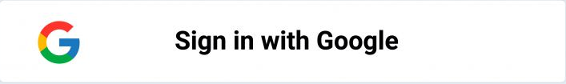
Log In / Sign Up
Company Name
Quality healthcare anytime, anywhere
Patient Sign In
Email
Password
Sign In
Notes:
Patient Sign In

Slide 7
Log In / Sign Up
Company Name
Quality healthcare anytime, anywhere
Doctor Sign In
Email
Password
Sign In
Notes:
Patient Sign In

Slide 8
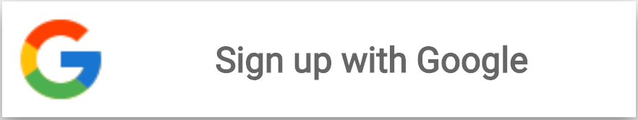
Company Name
Quality healthcare anytime, anywhere
Log In / Sign Up
Patient Sign Up
Name
Date of Birth
Email
Password
Re-enter Password
Sign Up
Notes:
Patient Sign Up

Slide 9
Company Name
Quality healthcare anytime, anywhere
Log In / Sign Up
Doctor Sign Up
Name
Date of Birth
Email
Password
Re-enter Password
Next
Notes:
Doctor Sign Up

Slide 10
Company Name
Quality healthcare anytime, anywhere
Log In / Sign Up
Your Profile
NPI Number
i
Your Communities
Practice Name
+ Add Community
Practice Location
State(s) authorized to practice
Next
Notes:
Doctor Profile

Slide 11
Company Name
Quality healthcare anytime, anywhere
Log In / Sign Up
Set Your Availability
Sunday
Thursday
to
to
10:30am
11:30pm
10:30am
11:30pm
+ Add Time Slot
+ Add Time Slot
Monday
Friday
to
to
10:30am
11:30pm
+ Add Time Slot
+ Add Time Slot
Tuesday
Saturday
to
to
10:30am
11:30pm
10:30am
11:30pm
+ Add Time Slot
+ Add Time Slot
Wednesday
to
+ Add Time Slot
Save
Notes:
Doctor Availability

Slide 12
Company Name
Quality healthcare anytime, anywhere
Book an Appointment
with Dr. Johal
Select Day
Description
Please describe what it is you would like to discuss with Dr. Johal.
Thursday, December 30th
Select Time
10:30am - 10:50am
11:30am - 11:50am
3:00pm - 3:20pm
Confirm
Notes:
Patient Booking

Slide 13
Company Name
Quality healthcare anytime, anywhere
You have successfully booked an Appointment!
with Dr. Johal
You will be sent an email confirmation with a calendar link and a zoom link
Add to Calendar
https://link-to-calendar-in-accessible-format-with-zoom-link
Zoom Link
https://zoom-link-where-doctor-is-host
Home
Notes:
Patient Booking End

Slide 14

Company Name
Quality healthcare anytime, anywhere
Log In / Sign Up
Your Dashboard
Upcoming Consultations
Have link to editable Open EMR in the Details
Total Stats
49 Consultations
36 5-star Ratings
4.7/5.0 Average Rating
Tuesday, December 28th, 9:00am - 9:20am
Details
Tuesday, December 28th, 10:00am - 10:20am
Details
Wednesday, December 28th, 2:30pm - 2:50pm
Details
23+ Hours of Pro-Bono Healthcare this month
i
Your Communities
Share on social media!
+ Add Community
Past Consultation Details
Notes:
Doctor Dashboard

Slide 15
Company Name
Quality healthcare anytime, anywhere
Log In / Sign Up
More Details
Previous Consultations
Consultation with Sam Smith
12/23/2021
Link to EMR
Edit EMR
Send EMR
Contact Patient
Consultation with Sally Mae
12/22/2021
Link to EMR
Edit EMR
Send EMR
Contact Patient
Consultation with Steve Stevens
12/19/2021
Link to EMR
Edit EMR
Send EMR
Contact Patient
Back to Dashboard
Notes:
Doctor Dashboard (More Details)

Slide 16
Company Name
Quality healthcare anytime, anywhere
Log In / Sign Up
Your Dashboard
Previous Consultations
Upcoming Consultations
Consultation with Dr. Sehej Johal
12/23/2021
Access EMR Here
Rate Consultation
Tuesday, December 28th, 9:00am - 9:20am
Details
Schedule Follow-Up
Tuesday, December 28th, 10:00am - 10:20am
Details
Consultation with Dr. Sehej Johal
12/23/2021
Access EMR Here
Rate Consultation
Wednesday, December 28th, 2:30pm - 2:50pm
Schedule Follow-Up
Details
Consultation with Dr. Sehej Johal
12/23/2021
Access EMR Here
Rate Consultation
Your Communities
i
Schedule Follow-Up
+ Add Community
Notes:
Patient Dashboard

Slide 17
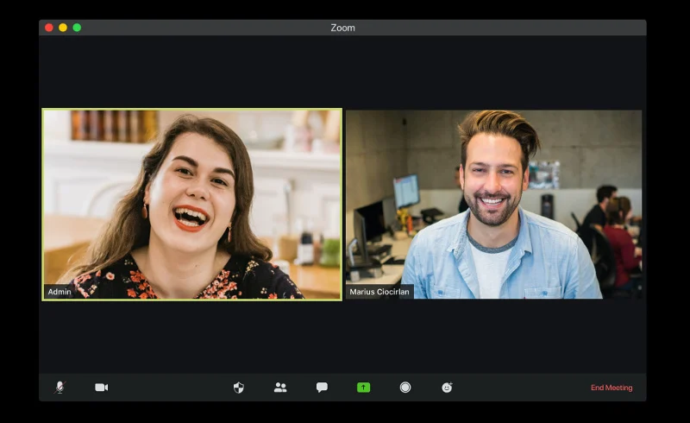
Company Name
Notes:
Zoom Screen

Slide 18
Company Name
Quality healthcare anytime, anywhere
Rate Consultation
with Dr. Sehej Johal
Description
In 1-3 sentences, please describe your experience with Dr. Sehej Johal.
Done
Notes:
Rating Doctor

